Slide 1
The Night Vision Integrated Performance Model NVIPM: Twisted Science by Trusted Authority
NVIPM is used to assess performance as part of the imager hardware acquisition process.
The Army accepted the Targeting Task Performance (TTP) image quality metric (IQM) as a replacement for the Johnson Criteria in 2001.
While the Army continues to use the TTP IQM name, a different metric is used in NVIPM.
The current Army modelers have never explained why the target acquisition model accepted by the Army in 2001 was changed.
No explanation, no experimental data, no theory, no excuses, just declarative statements that the original model is flawed, but in no instance have they offered details illustrating a problem.
Now, in an extreme twist of logic, journal papers are appearing saying the validation of the original TTP supports the different model in NVIPM.
Claiming that the validation of a different model supports the current model is a priori illogical and represents a disconcerting level of technical incompetence.
This is not about a technical disagreement. There is no technical justification for applying the validation of one model to a different model.

Slide 2
What did the current Army modelers change?
The original TTP IQM was a frequency domain model that compared eye threshold at each frequency to the spatial frequency content of the target at each spatial frequency.
Eye threshold is measured by vision scientists and called the Contrast Threshold Function (CTF).
A single frequency is a sine wave of infinite length, but vision scientists have discovered that between seven and eleven sine wave periods are enough to get an accurate threshold measurement.
Also, most researchers measuring CTF ensure that the eye is adapted to the display luminance, so even given that eleven sine wave periods are presented, the display luminance is made the same as the sine wave pattern over a large area.

Slide 3
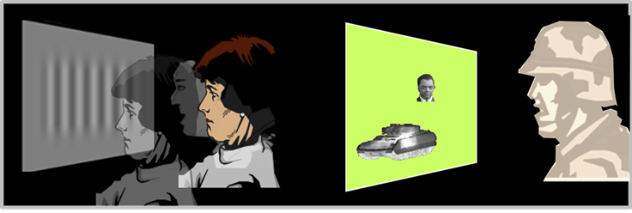
What did the current Army modelers misunderstand?
The CTF of several people with good eyesight are measured one at a time at left below and the average CTF used to represent the average soldier at right.
We represent the soldier at right with the measured sine wave thresholds.
The soldier’s eyes adapt to the sine wave luminance because of the whole screen, even though he is fixating the tank.
The tank is represented by the Fourier Transform of the tank.
Compare tank frequency content to frequency threshold of the eye.
C_{TGT} is target contrast, CTFsys is CTF adjusted for noise and blur, ε is spatial frequency, low and high are frequencies where C_{TGT} is less then CTFsys.

Slide 4
What did the current Army modelers change?
For no stated reason, no explanation, no experimental proof, no theory, and without being clear and forthright about what they have done, current Army modelers have started saying the TTP is what it never was.
They have decided that what they call CTF is illustrated in the figure below.
The sine wave patterns are limited in number of periods to the size of the target on the display; the rest of the display is dark.
Eyes not adapted to the display luminance and the wrong sine wave threshold are the foundation of NVIPM. Why?

Slide 5
What did the current Army modelers change?
Some image quality work was done decades ago looking at viewing television in a dark room. Back then, television display screens were small.
Whatever the reason the current army modelers have taken their approach, they have provided no validation, no explanation, no discussion of the utility.
If there is a reason, perhaps they should explain.
Now, journal articles are appearing that claim the validation of the original TTP supports this unexplained and unvalidated NVIPM approach.
It is clear the Futures Command will not take action.
It is a sad truth that the Futures Command has failed in their support of Army programs, apparently too busy, too important to control the work under their auspices.
It is clear that the editors of American journals will take no action to stop researchers falsely claiming their research is supported by the success of a different metric.
The number of “hangers on” who have jumped onto this fraudulent bandwagon is truly appalling.

